Slide 1
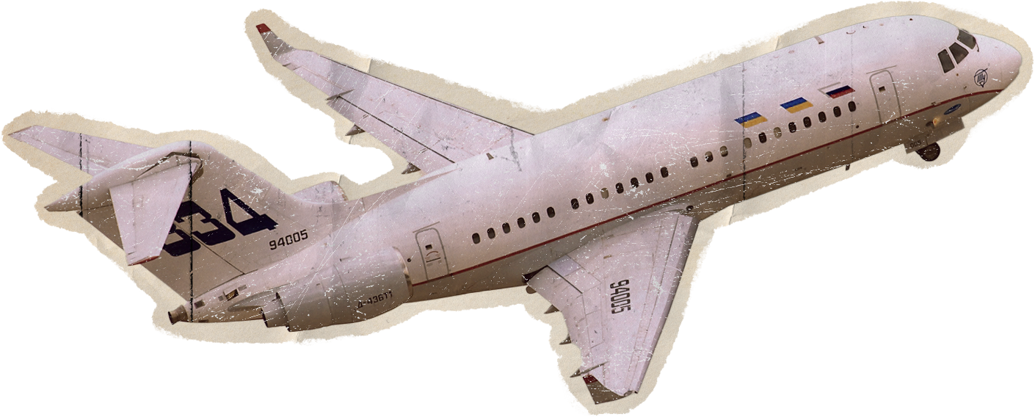




By Amun Intelligence Team
2015 Flight Delays and Cancellation

Slide 2


Team Members
The outstanding results of this project were only possible thanks to the collective effort of our talented team.
01.
02.
03.
04.
05.
Taha Ahmed Taha
Ahmed Hussein Hassan
George Gamil Sedky
Mostafa Saeed Mostafa
Mariam Mohamed

Slide 3

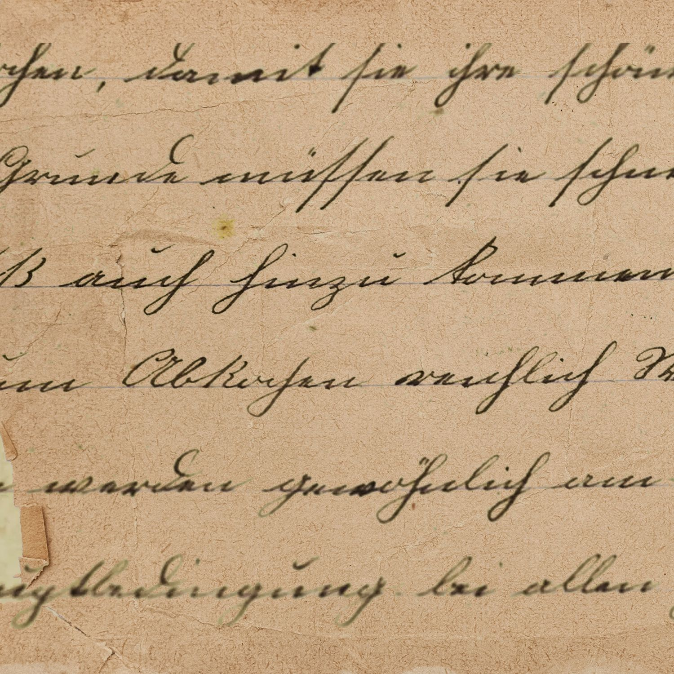
Agenda
01.
02.
03.
04.
05.
Introduction
Objectives
Data Cleaning
Data Analysis
Conclusions

Slide 4





01
Introduction
Flight disruptions, including cancellations and diversions, significantly affect airline operations and passenger experiences. This analysis examines these disruptions by exploring cancellation reasons and patterns across airlines and airports. Using data cleaned with Python, the goal is to provide insights that can help improve operational efficiency and reduce the impact of disruptions on travelers.

Slide 5
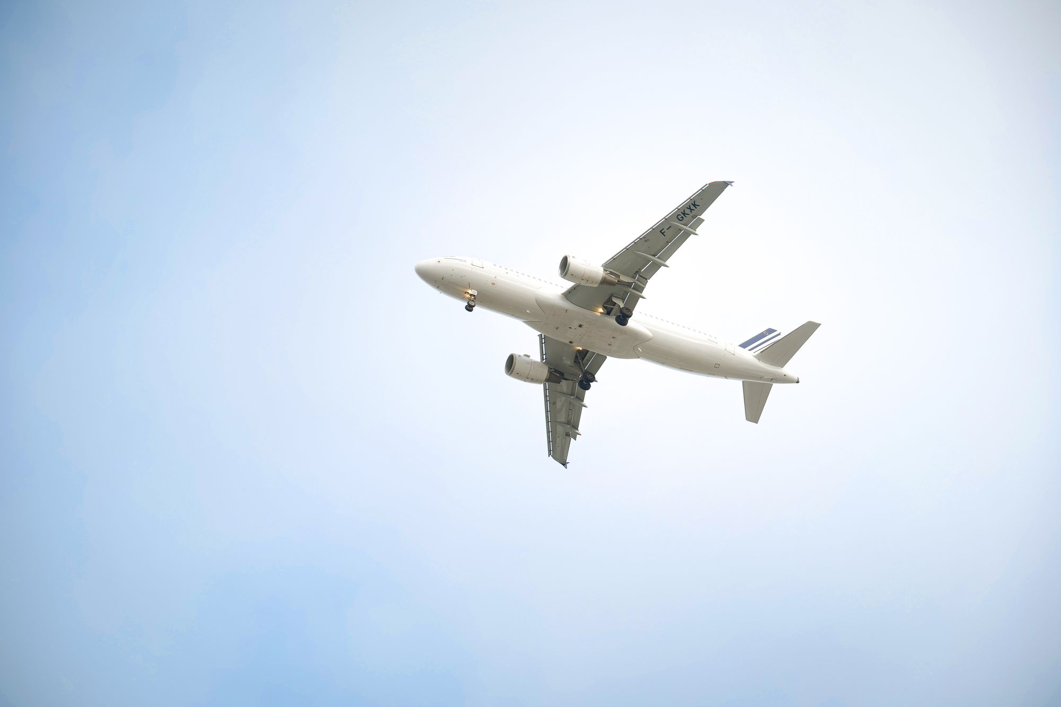
02
Objective
The goal of this data analysis is to provide a comprehensive understanding of flight disruptions by exploring cancellation reasons and diverted flights across different airlines and airports. The data was cleaned using Python to ensure accurate and reliable results, offering valuable insights into the patterns of flight disruptions. The analysis focuses on identifying the key factors affecting airline and airport performance, providing actionable insights that can help decision-makers improve operational efficiency and reduce the impact of disruptions on passengers

Slide 6

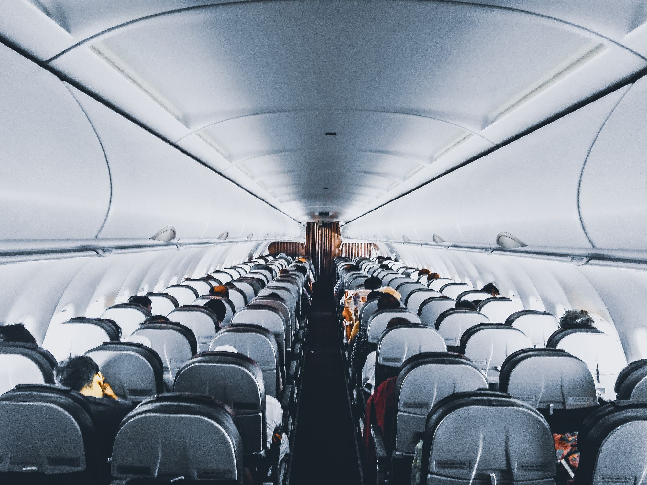
03
Data Cleaning

Slide 7




data cleaning Introduction
The dataset is composed of three CSV files: airlines.csv, airports.csv, and flights.csv.
The primary file, flights.csv, contains key columns, including: Date
Information: YEAR, MONTH, DAY, DAY_OF_WEEK.
Flight Identifiers: AIRLINE, FLIGHT_NUMBER, TAIL_NUMBER.
Flight Locations: ORIGIN_AIRPORT, DESTINATION_AIRPORT.
Timing Details: SCHEDULED_DEPARTURE, DEPARTURE_TIME, SCHEDULED_ARRIVAL, ARRIVAL_TIME.
Delays & Cancellations: DEPARTURE_DELAY, ARRIVAL_DELAY, TOTAL_DELAY, CANCELLED, CANCELLATION_REASON.
Flight Operations: TAXI_OUT, WHEELS_OFF, ELAPSED_TIME,
AIR_TIME, DISTANCE, WHEELS_ON, TAXI_IN.

Slide 8

Initial Data
Observations
Data Volume: Around 8 M of flight records spanning a specified time period.
Common Issues Identified:
Missing Values: The CANCELLATION_REASON column has approximately 98.46% missing values, while columns such as AIR_SYSTEM_DELAY, SECURITY_DELAY, AIRLINE_DELAY, LATE_AIRCRAFT_DELAY, and WEATHER_DELAY contain around 81.72% missing values.
Outliers: Extreme or inconsistent values in DEPARTURE_DELAY and ARRIVAL_DELAY.
Data Type Mismatches: Certain columns (e.g., time data) may have incorrect formats, such as being stored as text.

Slide 9
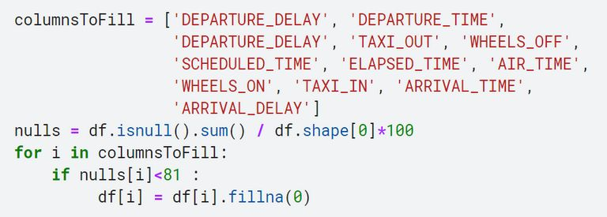
Data Cleaning Process
Handling Missing Values:
Replacing Null Values:
Since the percentage of missing values in these columns is small and won't significantly affect our analysis, the following columns were filled with appropriate replacements:
TAIL_NUMBER: 0.25% missing .dropna()
DEPARTURE_TIME: 1.5% missing
DEPARTURE_DELAY: 1.5% missing
TAXI_OUT: 1.5% missing
WHEELS_OFF: 1.5% missing
SCHEDULED_TIME: 0.0001% missing
ELAPSED_TIME: 1.8% missing
AIR_TIME: 1.8% missing
WHEELS_ON: 1.6% missing
TAXI_IN: 1.6% missing
ARRIVAL_TIME: 1.6% missing
ARRIVAL_DELAY: 1.8% missing

Slide 10
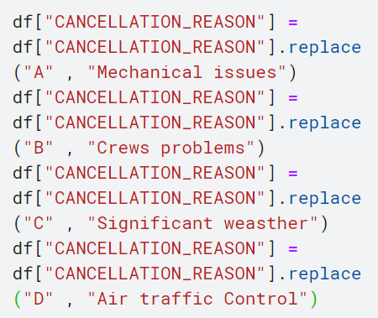
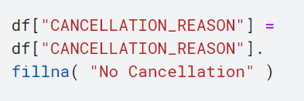
Data Cleaning Process
Handling Missing Values:
Replacing Values with:
A: Mechanical issues with the aircraft.
B: Crew-related problems (e.g., staffing shortages, pilot illness).
C: Significant weather events (e.g., storms, blizzards, low visibility).
D: Air traffic control issues, security concerns, or national aviation system delays.
Replacing Null Values in CANCELLATION_REASON:
Filled missing values in the CANCELLATION_REASON column with "No Cancellation."

Slide 11
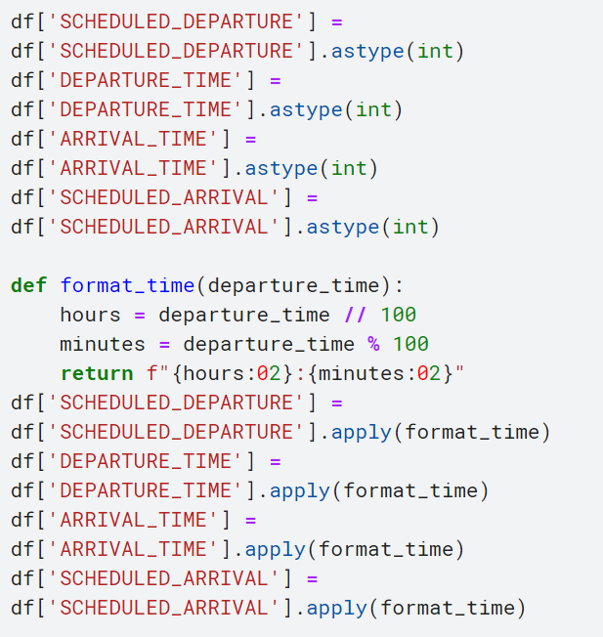
Data Cleaning Process
Time Format Conversion:
In this step, we convert time columns (e.g., SCHEDULED_DEPARTURE, DEPARTURE_TIME, ARRIVAL_TIME, SCHEDULED_ARRIVAL) from integer format to a readable "HH
format. This is done by breaking down the time into hours and minutes using a custom function, format_time(), ensuring that the data is standardized and easier to interpret for further analysis.

Slide 12
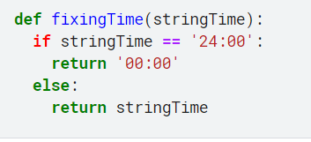
Data Cleaning Process
Function Description: fixingTime
This function takes a string representing time in the format "HH:MM" and corrects any instances where the time is listed as "24:00". Since "24:00" is not a valid time format (it should be "00:00" for midnight), the function converts it to "00:00". For all other time values, the function returns the input string unchanged.
Input: A string representing time (e.g., "24:00", "14:30")
Output: The corrected time string (e.g., "00:00" if input is "24:00", otherwise returns the original string)

Slide 13
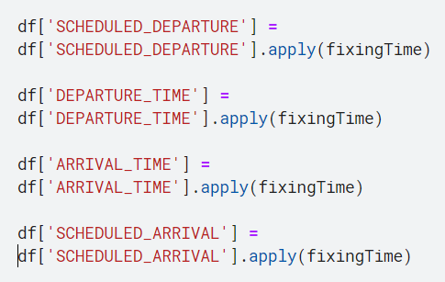
Data Cleaning Process
Handling Time Formatting Issues:
To ensure consistent and valid time values, we applied the fixingTime() function to correct any instances where time is incorrectly listed as "24:00", converting it to "00:00" for proper midnight representation. This ensures that the time columns (SCHEDULED_DEPARTURE, DEPARTURE_TIME, ARRIVAL_TIME, SCHEDULED_ARRIVAL) have accurate and standardized values.

Slide 14
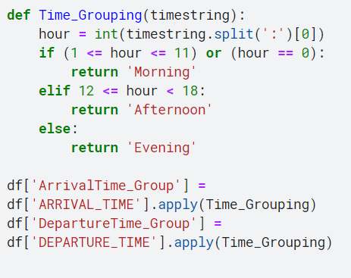
Data Cleaning Process
Time Grouping by Period of Day:
We created a Time_Grouping() function to categorize flight times into three periods: Morning, Afternoon, and Evening. This function converts the time values into hour-based groups for both ARRIVAL_TIME and DEPARTURE_TIME, allowing for easier analysis of flight trends based on the time of day.

Slide 15
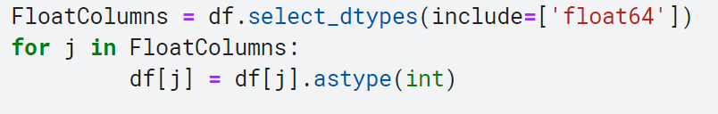
Data Cleaning Process
Converting Float Columns to Integer:
To optimize the dataset and ensure consistency, we identified all columns with floating-point values and converted them to integer type where applicable. This process helps in reducing memory usage and ensures the precision required for further analysis.

Slide 16
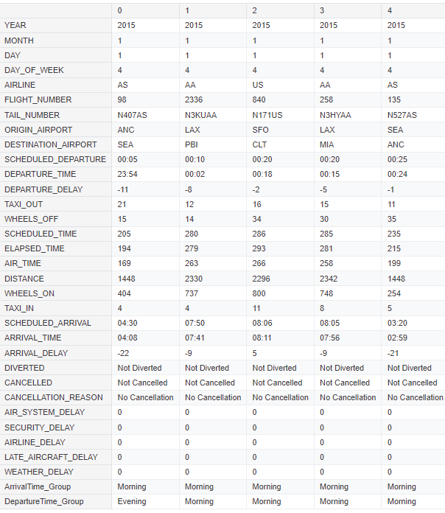
Data After Cleaning Process

Slide 17


04
data analysis and visualization

Slide 18

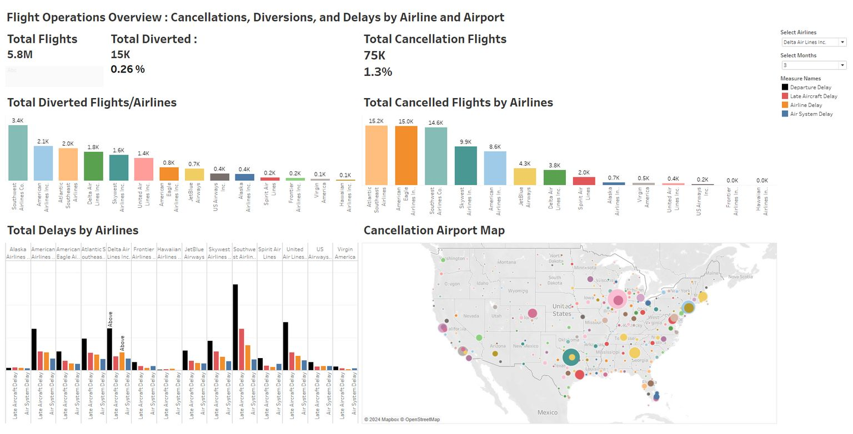
data analysis and visualization
Insight
cancelattion and Diversion rate below the acceptable range for civil Aviation Authorities and airlines as below 2-3%
2. Total delays are above the acceptable range 15-20%
Dashboard 1

Slide 19
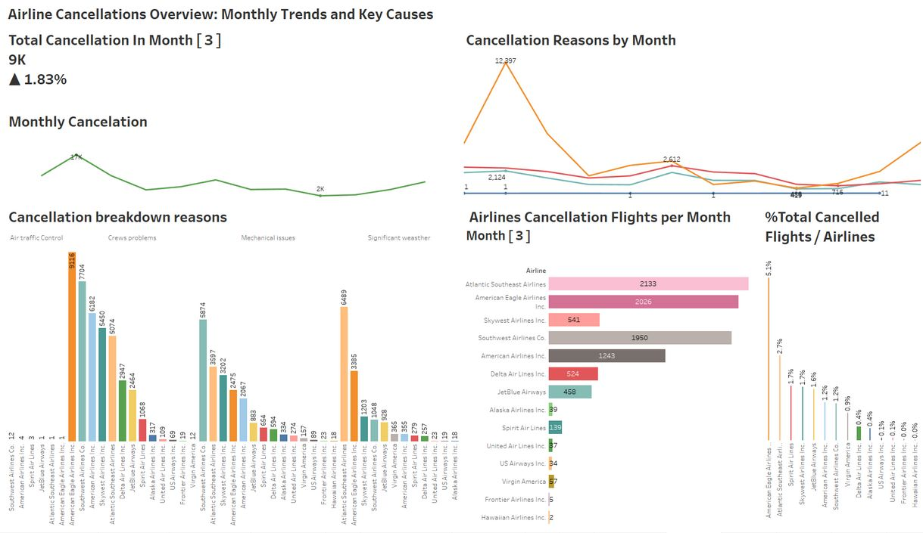
data analysis and visualization
Insight
American Airlines, Southwest Airlines, and Delta Airlines experience the highest number of cancellations, with crew and mechanical issues being the most common cause.
Weather, while a factor, is not the leading cause of cancellations; most issues are related to operational problems (crew and mechanical issues).
Dashboard 2
3. Spirit Airlines has a notably high percentage of cancellations relative to its flight volume

Slide 20
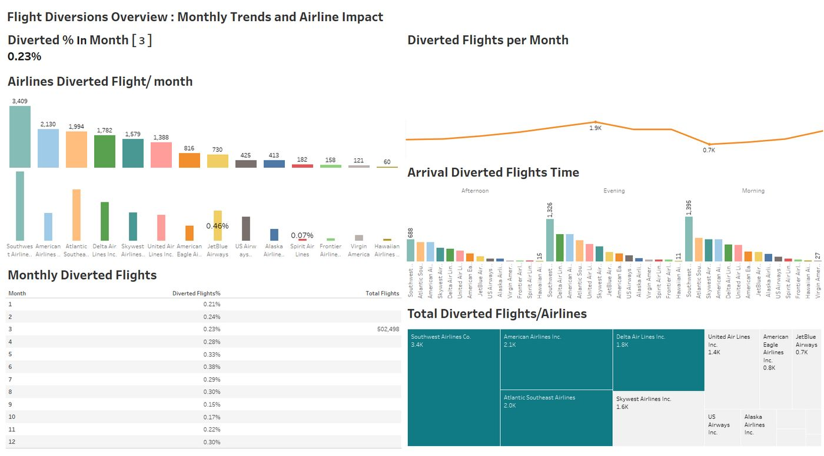
data analysis and visualization
Insight
June has highest diverted while Sep has the lowest
Southwest , Atlantic and Delta has the highest percetange all over thier flights
Morning and Evenening has the most Diverted flights
Dashboard 3

Slide 21
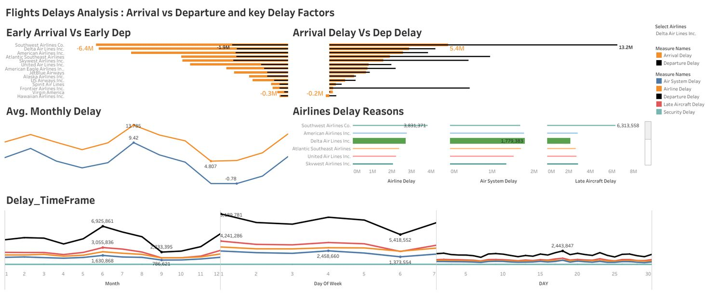
data analysis and visualization
Insight
Most flights depart on time or a little early,as same as arriving more early or on time but there are a few flights with significant delays that are impacting the average delay time, same as arriving delay time
Delta Airline has high depurture delay but manage to arrive early
average monthly delay was more than 13mins as departure delay and 9 min as arrival delay in June
AirSystem, Airline , late aircraft , security delay was highest in june
Delay was above the average
Dashboard 4

Slide 22
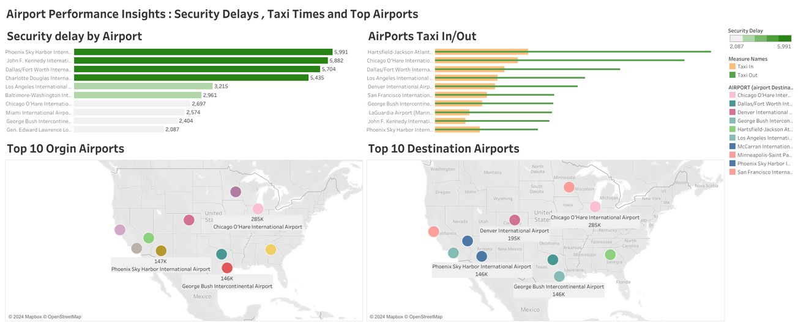
data analysis and visualization
Insight
Security Delay and Taxi in/out was below the acceptable mins as for taxi in/out 20mins and security delay as 30 mins
Dashboard 5

Slide 23
05
Conclusions
Impact: Flight disruptions significantly affect airline operations and passenger experiences.
Data Cleaning: Addressed missing values, outliers, and data type mismatches.
Rates: Cancellation and diversion rates were below the acceptable range (2-3%).
Airlines: American, Southwest, and Delta had the most cancellations due to crew and mechanical issues. Spirit Airlines had a high cancellation rate.
Trends: June had the most diverted flights; September had the least. Morning and evening flights were most often diverted.
Delays: Most flights were on time, but significant delays impacted averages. Delta had high departure delays but arrived early. June had the highest delays.
Efficiency: Security delays and taxi times were within acceptable limits.

Slide 24


Amun Intelligence Team
Thank
you

